Slide 1
Mastering Blockchain Third Edition
Chapter 13, Ethereum Development Environment

Slide 2
Outline
Test networks
Private network components
Starting up the private network
Mining on the private network
Remix IDE
MetaMask
Using MetaMask and Remix IDE to deploy a smart contract

Slide 3
Test networks
--testnet Ropsten network: pre-configured Proof of Work test network
--rinkeby Rinkeby network: pre-configured Proof of Authority test network
--goerli Görli network: pre-configured Proof of Authority test network

Slide 4
Create a private net
In order to create a private net, three components are needed:
Network ID
The genesis file
A data directory to store blockchain data

Slide 5
Ethereum node discovery
The Ethereum network stack consists of several protocols, including Discovery, RLPx, DevP2P, and capability protocols
The diagram shows Discovery, RLPx, DevP2P, capability protocols from left to right, in the order of invocation at the time of a node starting up

Slide 6
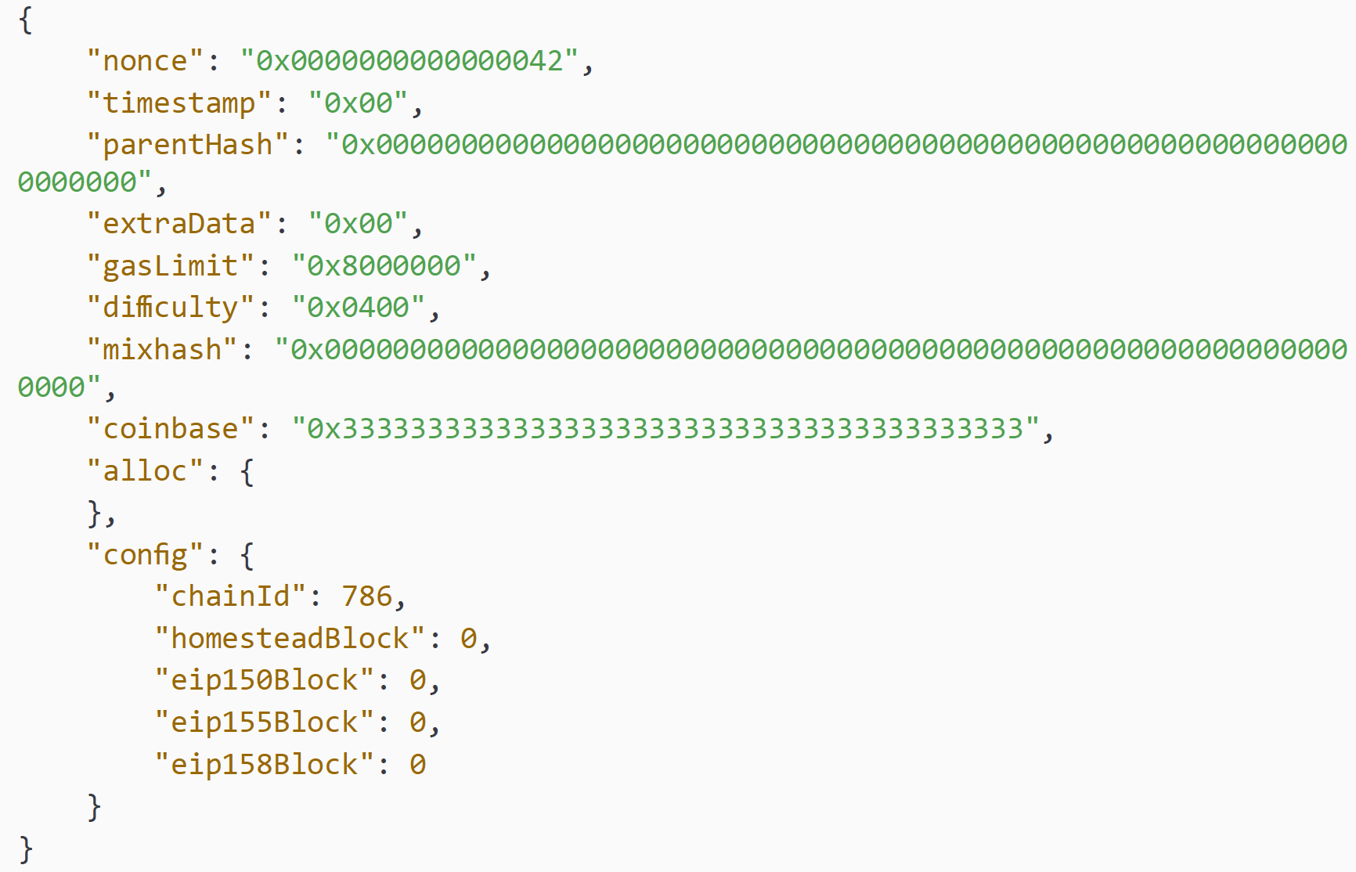
Genesis file
As follows is the Ethereum blockchain genesis file, which defines the chain configuration

Slide 7
Remix IDE
Remix IDE is an Ethereum contract development environment, which supports several plugins and has many useful features

Slide 8
Remix IDE debugger
Remix IDE’s debugger is a useful debugging tool, which shows a disassembly of the contract code and allows a user to step through the code to aid the debugging process

Slide 9
MetaMask
MetaMask works as a cryptocurrency wallet (as shown in the left image) and can connect with different Ethereum networks (as shown in the right image)

Slide 10
Exercise
In your own time, run simplecontract2 in the Remix IDE, following the instructions in the Mastering Blockchain core book.

Slide 11
Summary
In this presentation, we considered:
Test networks
Private network components
Starting up the private network
Mining on the private network
Remix IDE
MetaMask
How to use MetaMask and Remix IDE to deploy a smart contract

